Slide 1
Matlab NNtoolbox
操作過程

Slide 2
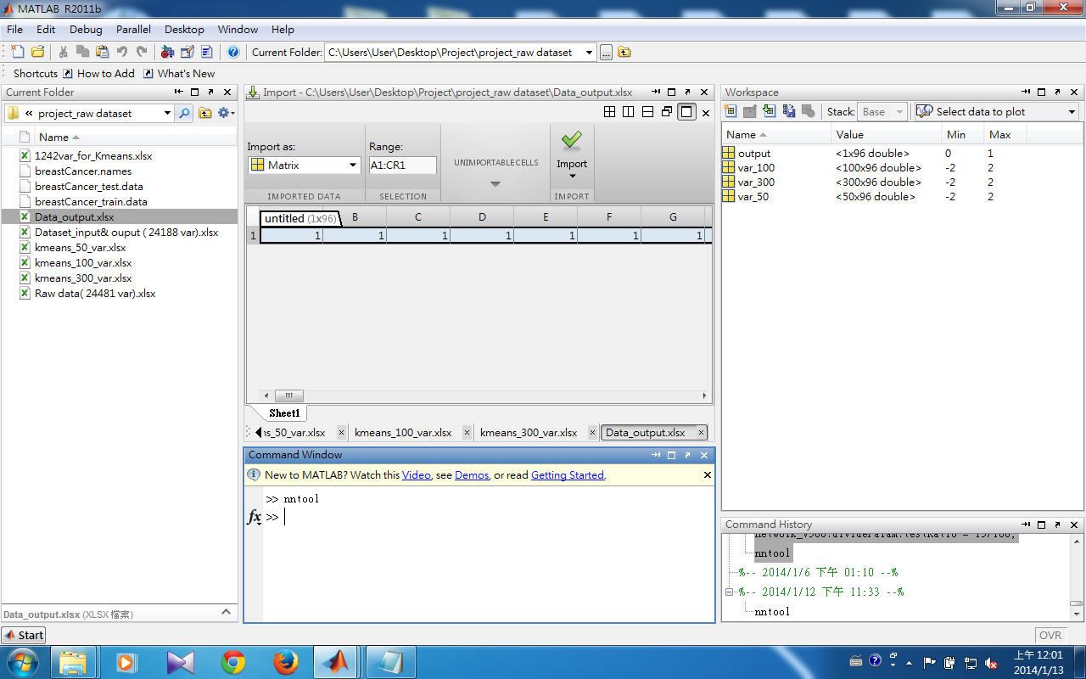
先把要用到的input& output import到 workspace

Slide 3
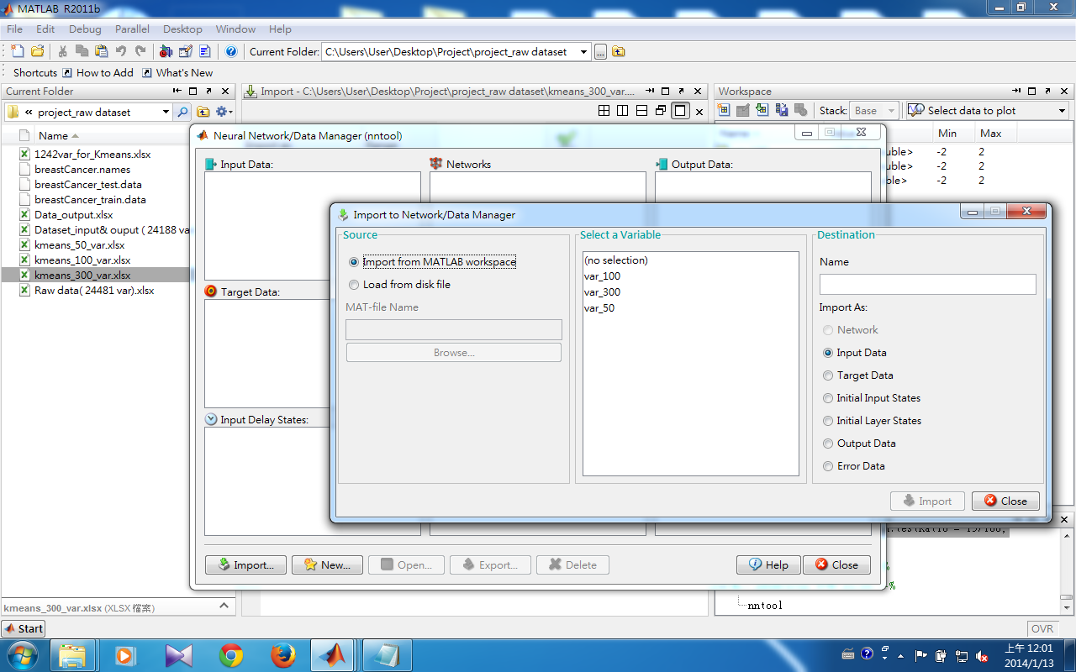
選擇要import的data set
以及是input data 還是 target data
按下import

Slide 4
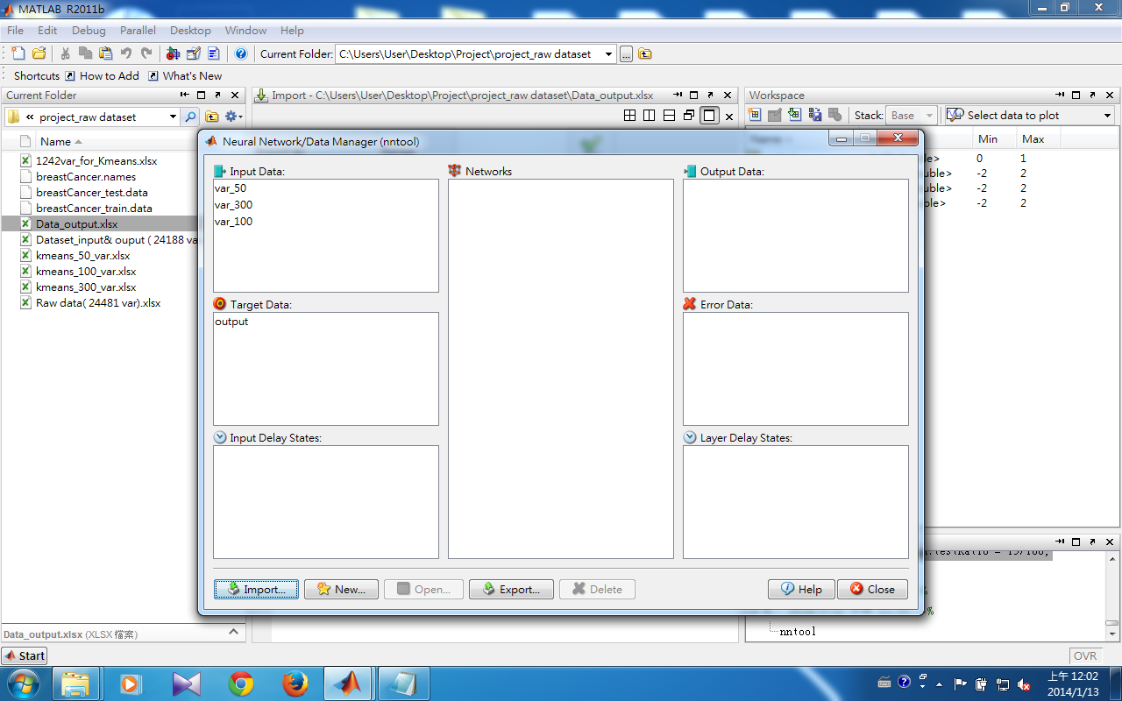
接著在command window輸入nntool
就會跳出所提供的介面
將要用來建立model的data set import完之後按下new來建一個新的NN model

Slide 5
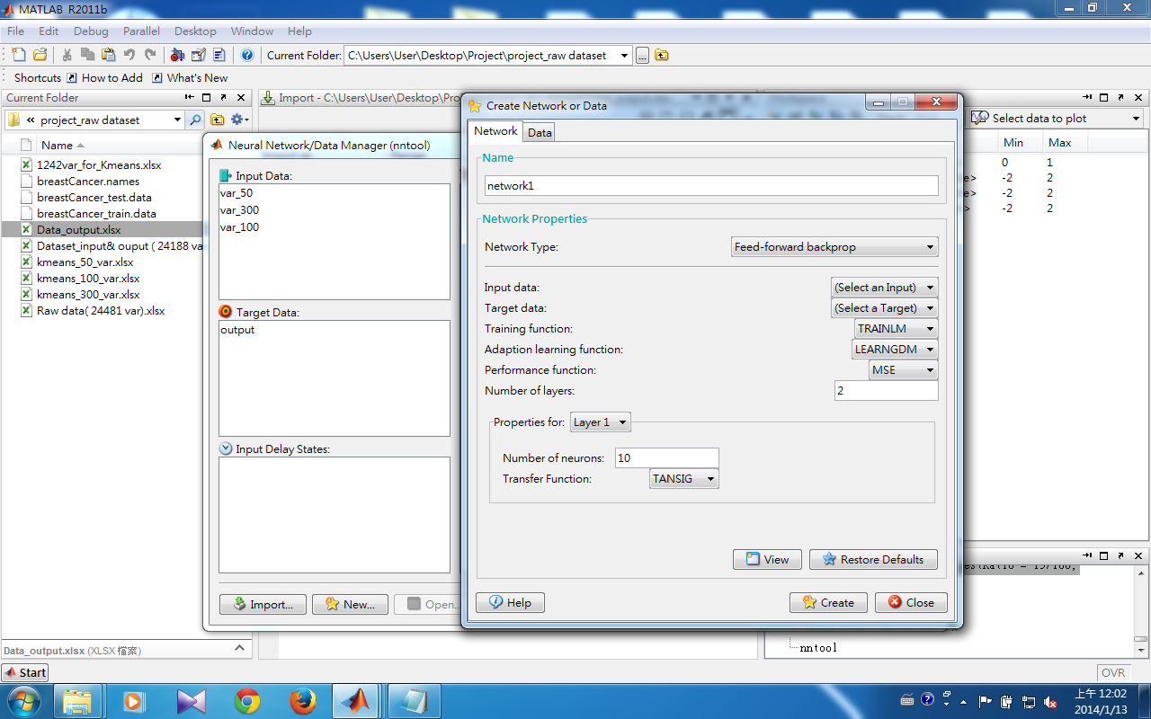
選擇想要的參數設定
這裡只是簡單的一些基本參數設定若想要的參數設定不在這裡，建完model之後將network export到workspace在修改參數
設定好了之後
create model

Slide 6
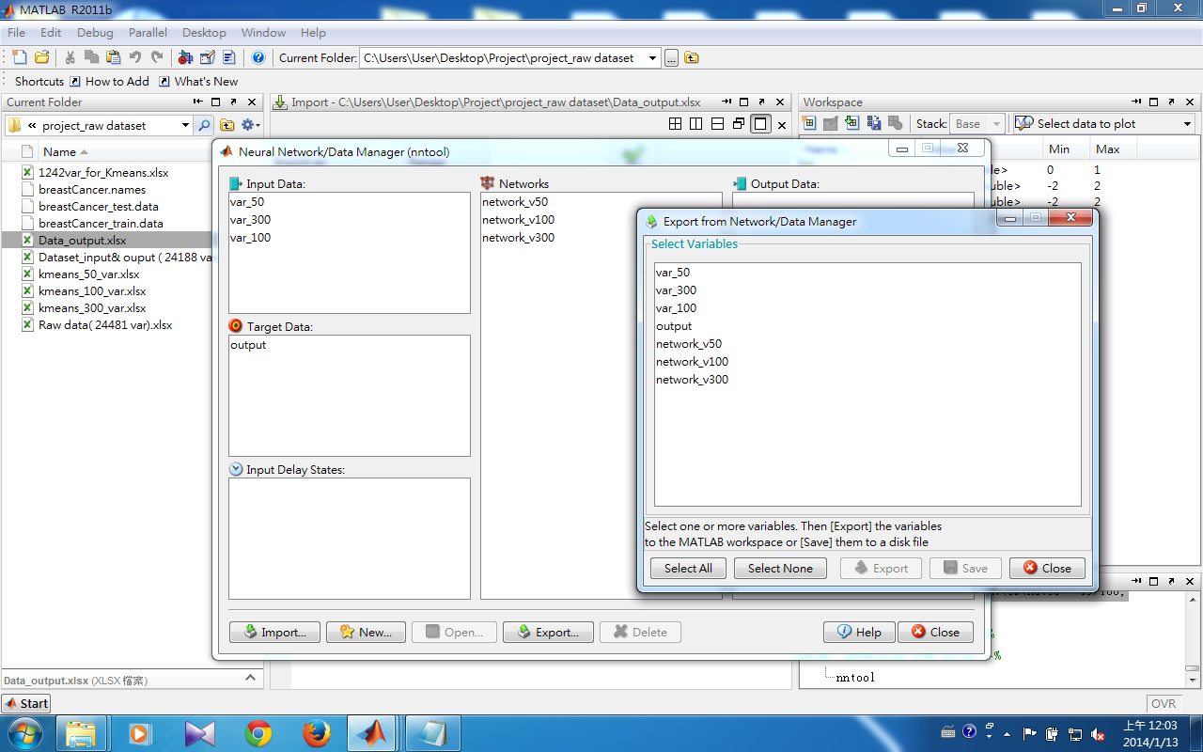
想要修改model的參數將network export到
workspace

Slide 7
%-- matlab nntoolbox --
%我在matlab command window中依序輸入以下程式碼調整 NN:
network_v50.plotFcns = {'plotperform','plottrainstate','ploterrhist','plotconfusion','plotregression', 'plotfit’}
network_v50.divideFcn = 'divideblock’;
network_v50.divideMode = 'sample’;
network_v50.plotFcns = {'plotperform','plottrainstate','ploterrhist','plotconfusion','plotregression', 'plotfit'};
network_v50.divideFcn = 'divideblock’;
network_v50.divideMode = 'sample’;
network_v50.divideParam.trainRatio = 70/100;
network_v50.divideParam.valRatio = 15/100;
network_v50.divideParam.testRatio = 15/100;
network_v100.plotFcns = {'plotperform','plottrainstate','ploterrhist','plotconfusion','plotregression', 'plotfit'};
network_v100.divideFcn = 'divideblock’;
network_v100.divideMode = 'sample’;
network_v100.divideParam.trainRatio = 70/100;
network_v100.divideParam.valRatio = 15/100;
network_v100.divideParam.testRatio = 15/100;
network_v300.plotFcns = {'plotperform','plottrainstate','ploterrhist','plotconfusion','plotregression', 'plotfit'};
network_v300.divideFcn = 'divideblock’;
network_v300.divideMode = 'sample’;
network_v300.divideParam.trainRatio = 70/100;
network_v300.divideParam.valRatio = 15/100;
network_v300.divideParam.testRatio = 15/100;
關於matlab的NN 參數設定（有哪些參數＆參數之功能與意義）
可請教Google大神 或 查閱Neural Network Toolbox User’s Guide :
http://www.mathworks.com/help/pdf_doc/nnet/nnet_ug.pdf

Slide 8
另外matlab還有提供nnstart GUI :
如果你是要建立以下四種neural network
neural network fitting
pattern recognition
clustering
time series wizards
- 是相當方便的工具

